Slide 1
Game Development:
“The Hunt”
A game developed using Unity Engine

Slide 2
UNITY
Unity is a cross-platform game engine developed by Unity Technologies, first announced and released in June 2005 at Apple Inc.'s
Worldwide Developers Conference as a Mac OS X-exclusive game engine. As of 2018, the engine had been extended to support more than 25
platforms. The engine can be used to create three-dimensional, two-dimensional, virtual reality, and augmented reality games, as well
as simulations and other experiences.The engine has been adopted by industries outside video gaming, such as film, automotive,
architecture, engineering and construction.
Several major versions of Unity have been released since its launch. The latest stable version, 2019.2.14, was released in
November 2019.

Slide 3
Introduction & Overview:
A game played by electronically manipulating images produced by a computer program on a monitor or other display. - Oxford Dictionary
Purpose:
Entertainment
Challenging
Awareness
Aspects:
Mechanics of a Game
Graphic Designing
Scope:
Horror
Excitement

Slide 4
Problems Analysis:
01
Plot & Design Aesthetics: The Plot story plays a major role that shape the following tasks and assumptions. The first stage designing and then graphically implementing it using third party software, Maya Autodesk and Unity engine itself to create the map.
02
Sound design and implementation: This was a parallel step undertaken along with designing of assets and maps, depending on the assumptions with respect to the plot of the game.
03
Scripting & Rendering: Coding of all the assets as well as the game mechanics were done in C#. The game was rendered in Unity Engine and further tested for optimicity and bugs.

Slide 5



Target audience
Prolific Gamers.
Horror Games are used to psychologically simulate trauma to phobic patients for their treatment.
Regular people who are interested to discover new thing and try out obscure or rather unique genre of products.

Slide 6
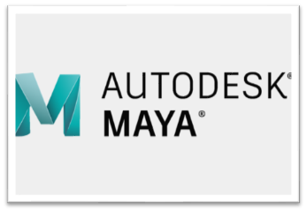

Modelling and Design:
Softwares Used:
Autodesk Maya
Autodesk 3D Max

Slide 7
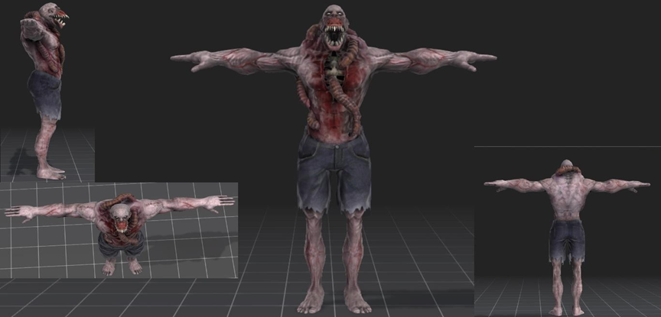
Assets Created:
The Villain:

Slide 8
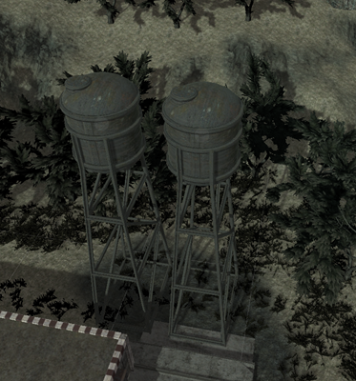
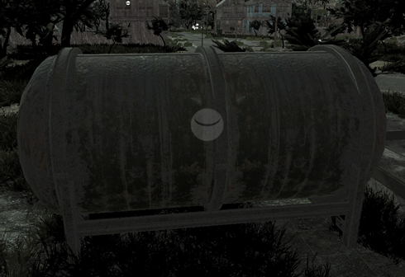
Tower and Silos:

Slide 9
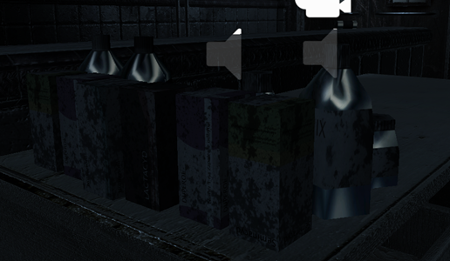
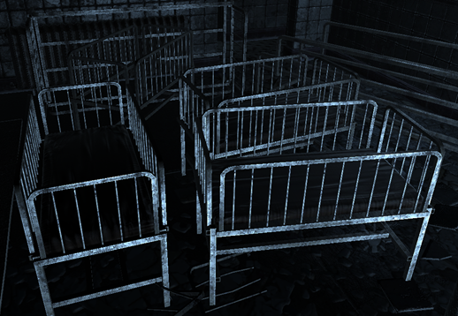
Random Items:

Slide 10
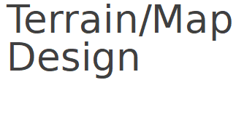
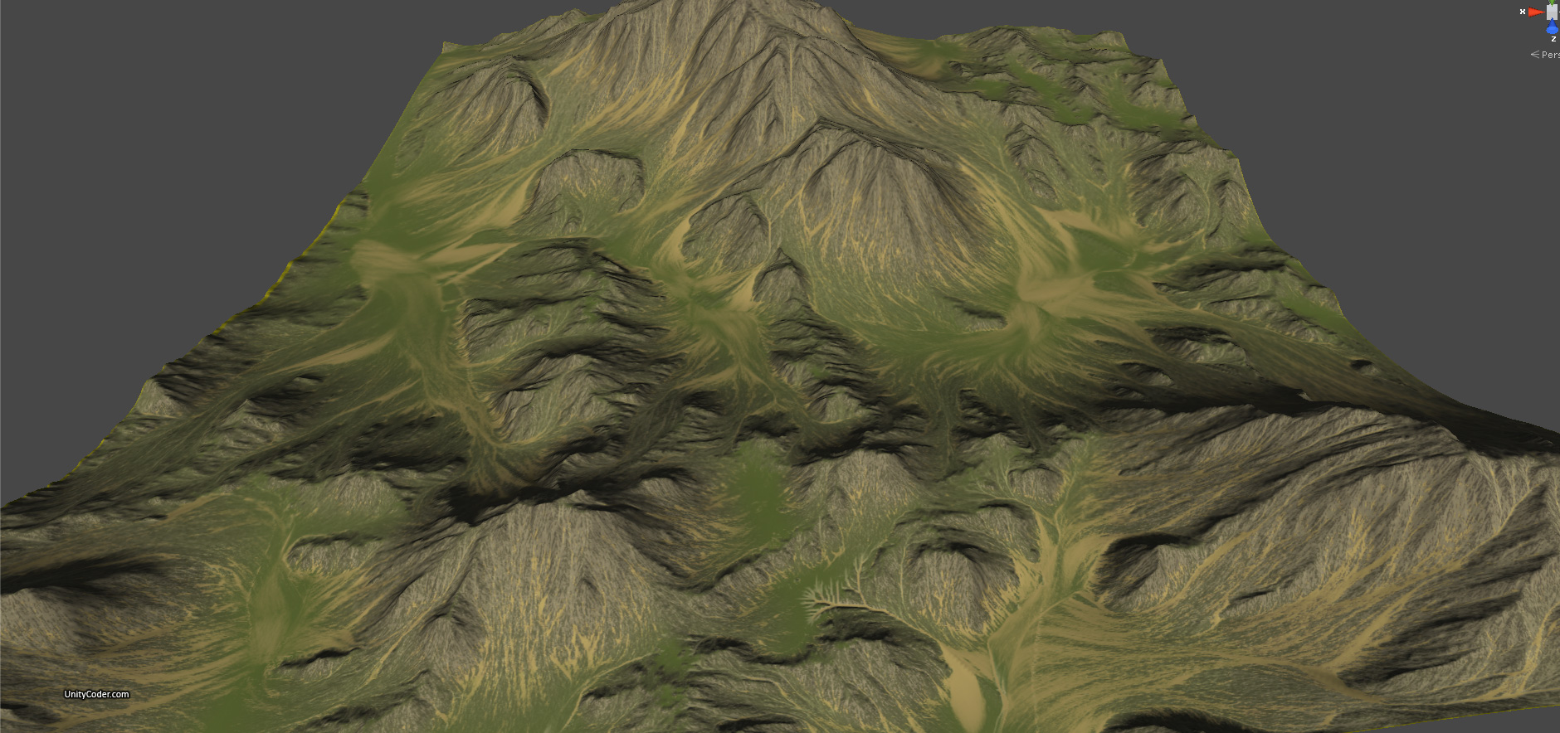
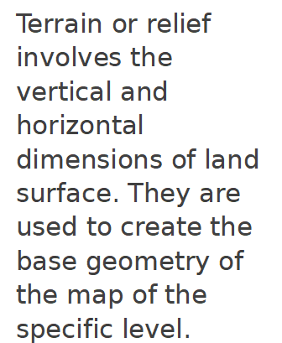

Slide 11
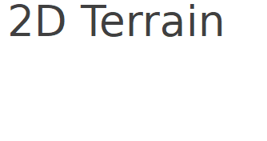
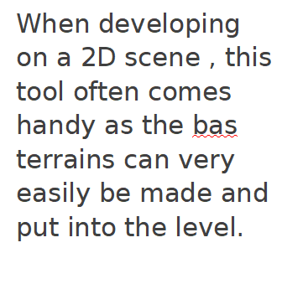
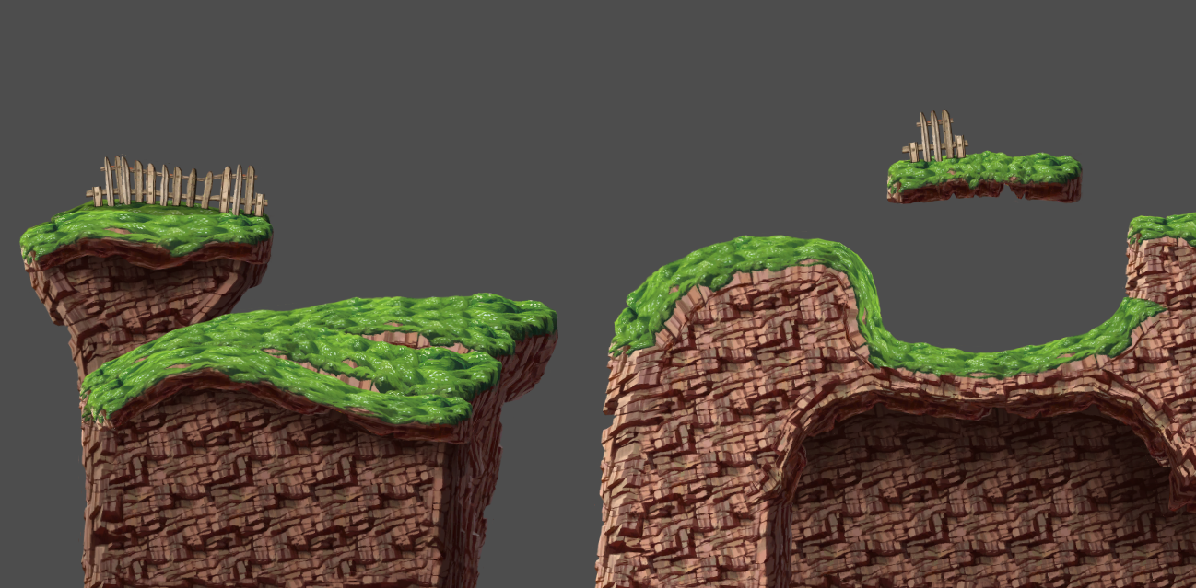

Slide 12
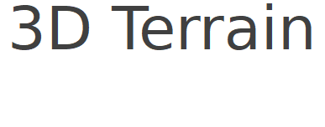
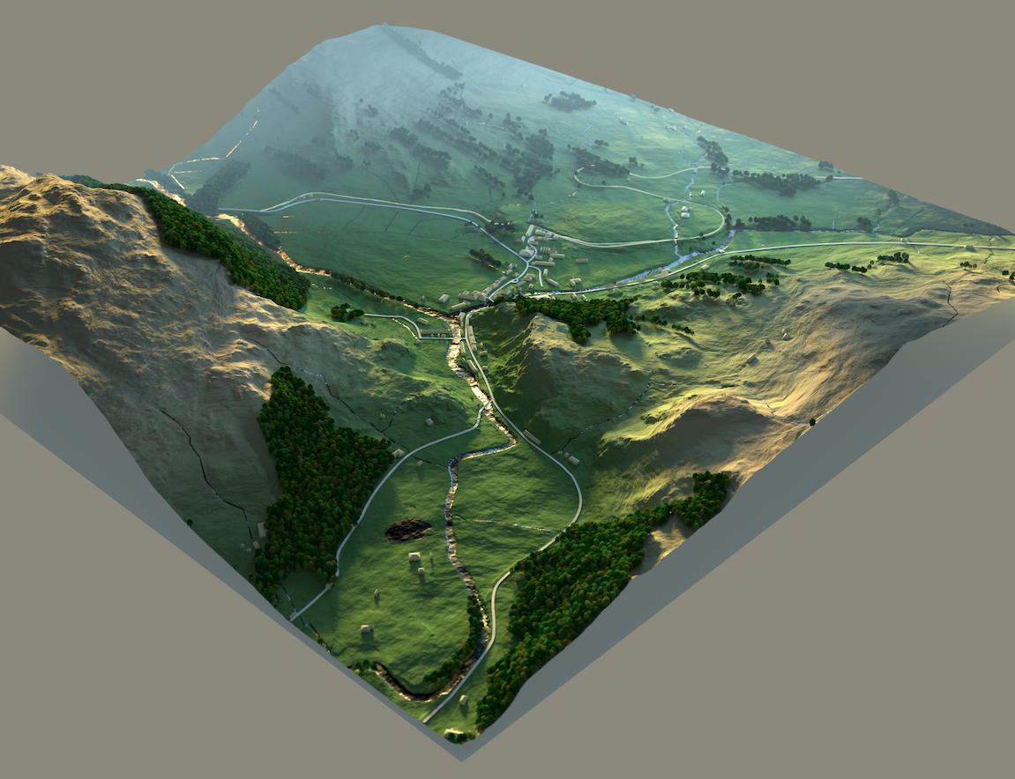
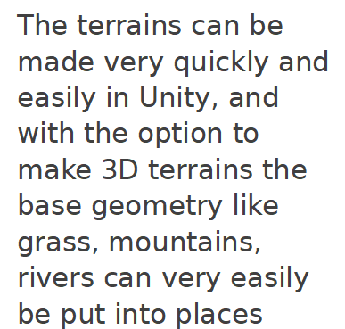

Slide 13
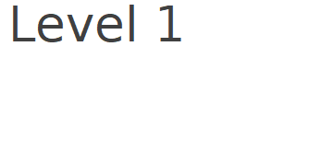
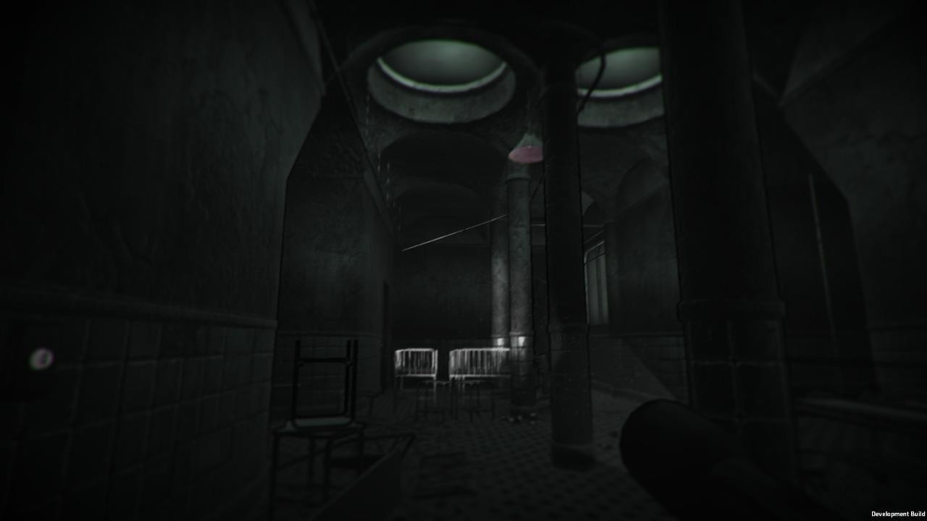
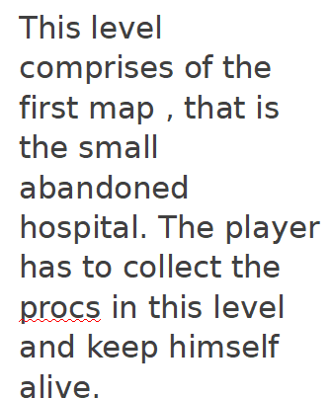

Slide 14
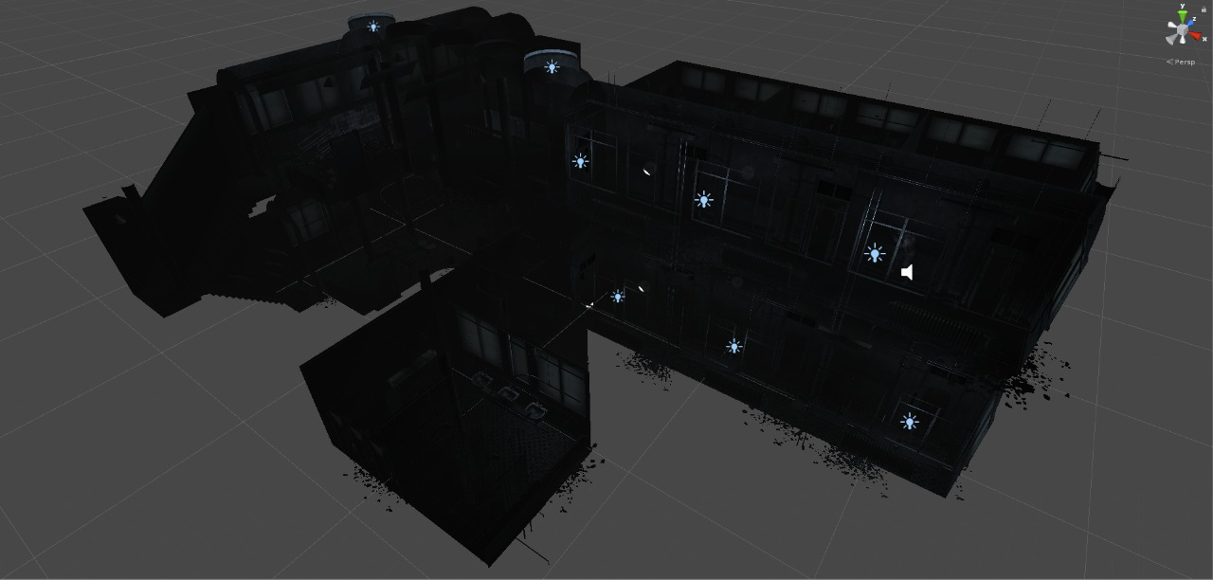
Level 1 Top View

Slide 15
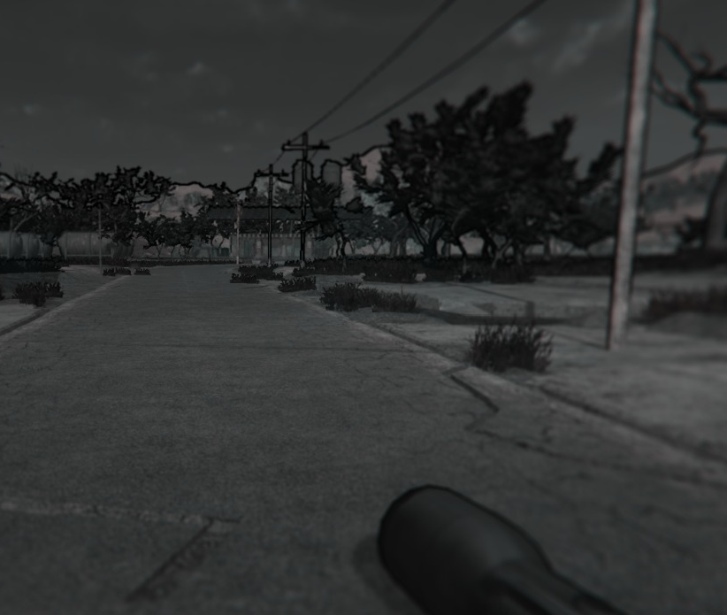
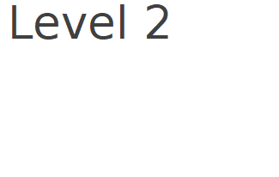
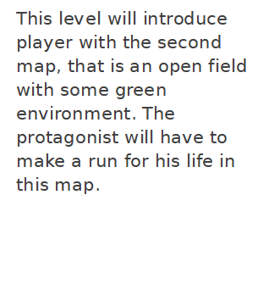

Slide 16
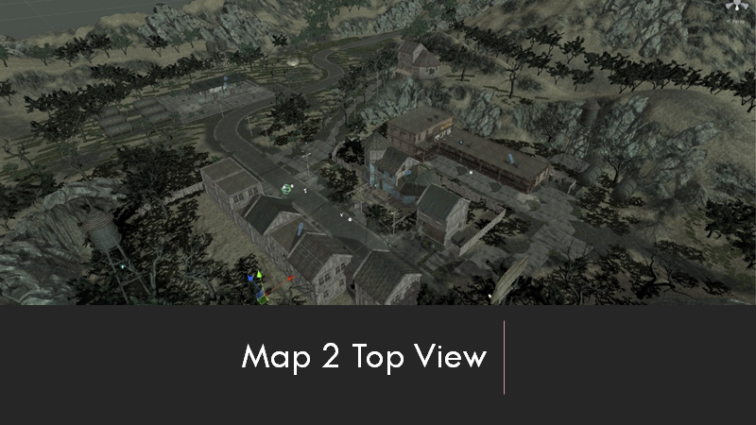

Slide 17

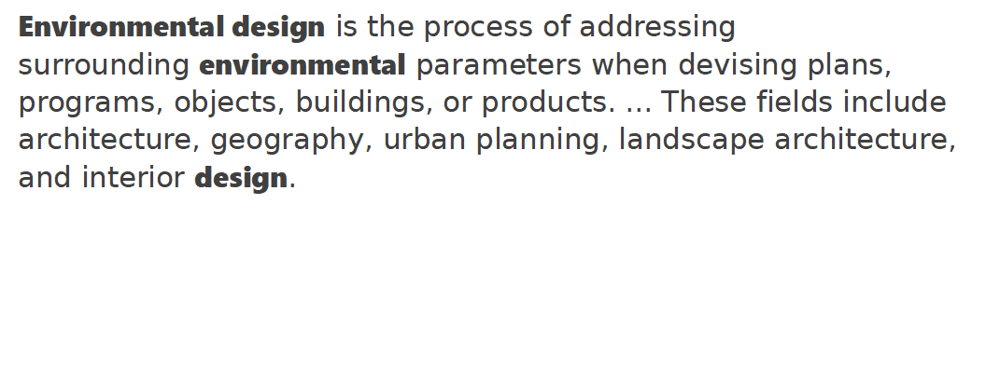

Slide 18
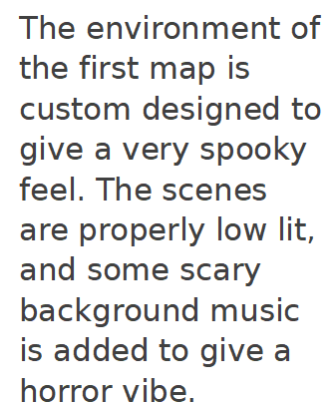
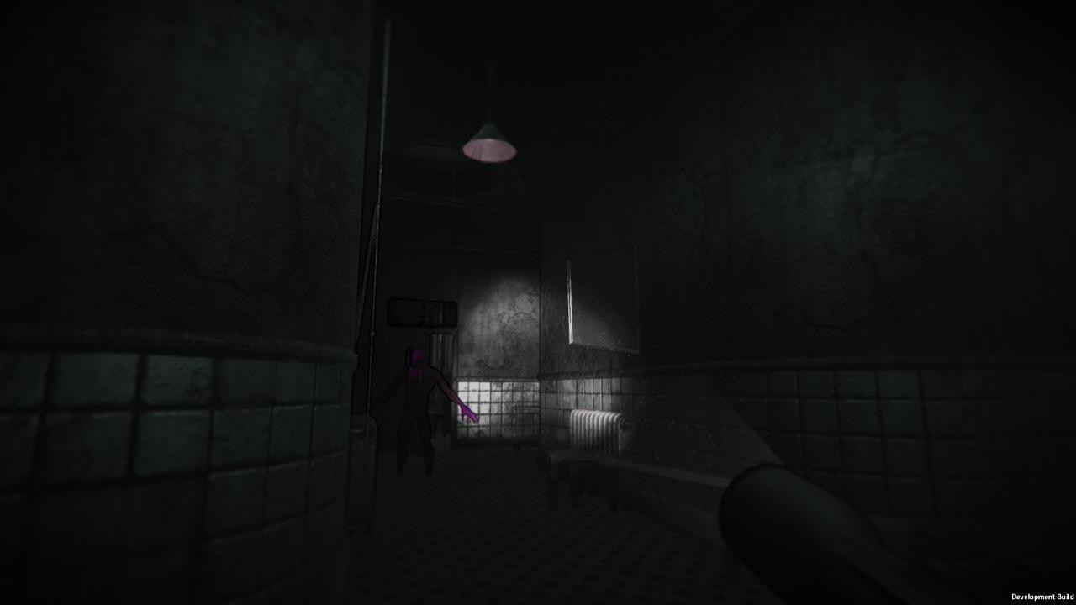
Environment Design Of Map 1

Slide 19
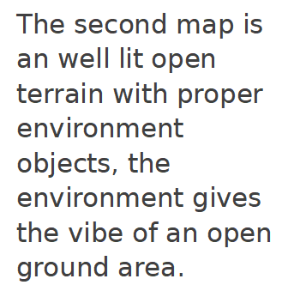
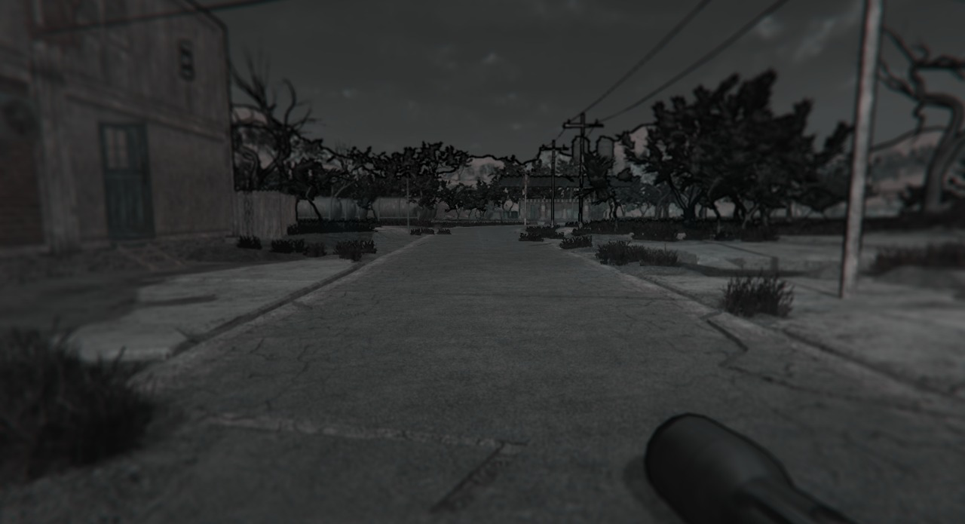
Environment Design Of Map 2

Slide 20

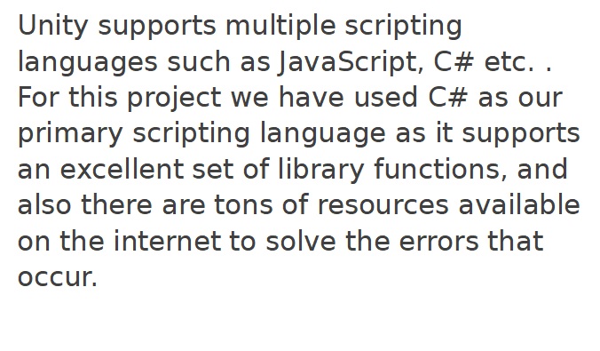
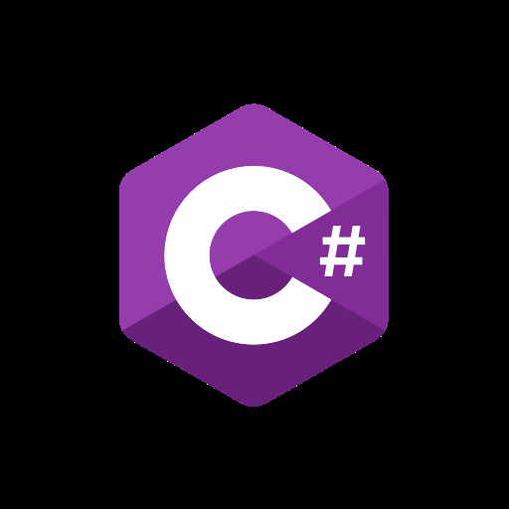

Slide 21

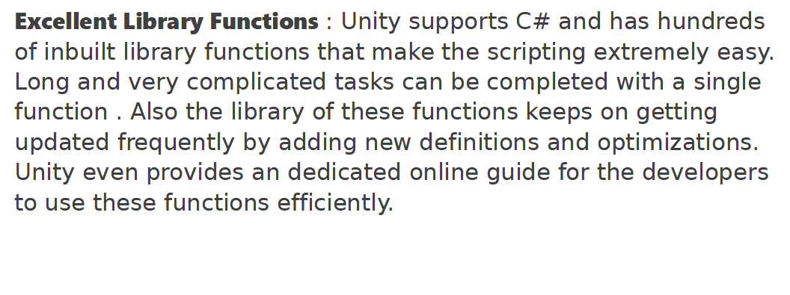

Slide 22
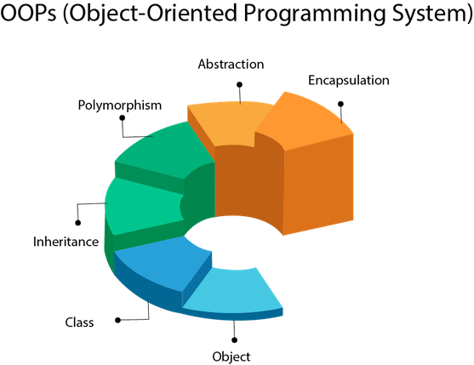
Object Oriented : C# is object oriented programming language. OOPs makes development and maintenance easier where as in Procedure-oriented programming language it is not easy to manage if code grows as project size grow.

Slide 23

Easy to learn : C# is a simple language in the sense that it provides structured approach (to break the problem into parts), rich set of library functions, data types etc.
Speed : The compilation and execution time of C# language is fast.

Slide 24
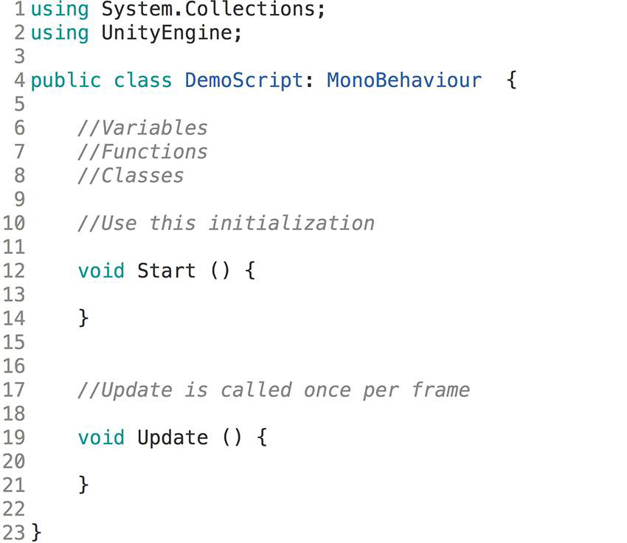
Structured Programming Language :
C# is a structured programming language in the sense that we can break the program into parts using functions. So, it is easy to understand and modify.

Slide 25
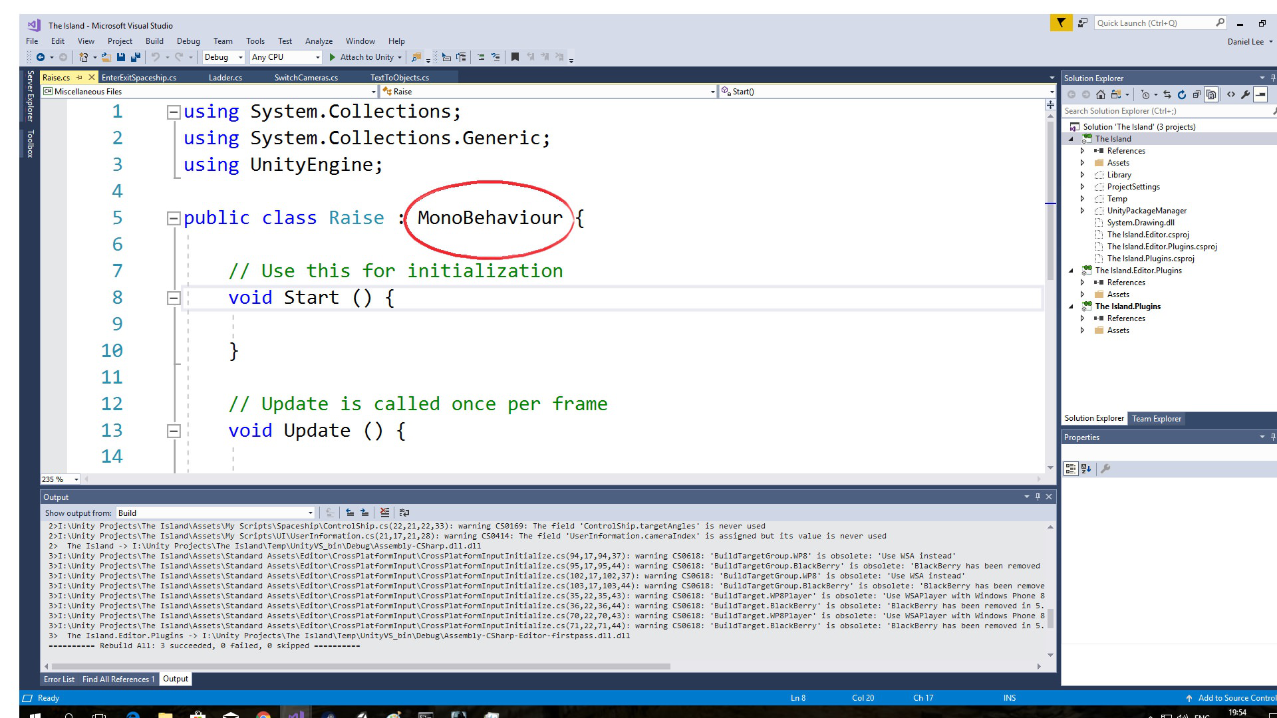
Compiler Used :
Visual Studio : Visual Studio extensively supports Unity and it’s scripts. It provides an excellent environment where developers can code and debug their scripts.

Slide 26
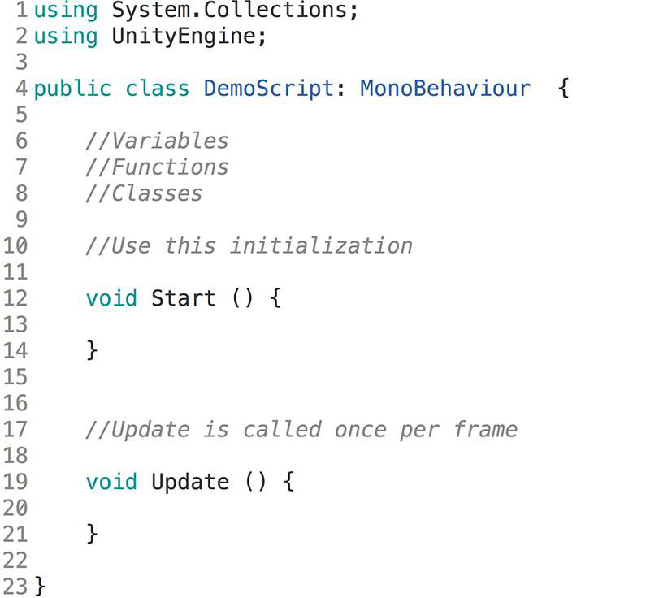
Basic Structure of Every Unity Script

Slide 27
Sample Script for Moving an Object
using UnityEngine;
public class PlayerController : MonoBehaviour {
Rigidbody rb;
public float speed = 10.0f;
void Start () {
rb = GetComponent<Rigidbody>();
}
void Update () {
if (Input.GetKey(KeyCode.RightArrow)){
rb.velocity = transform.right * speed;
}}}

Slide 28
Sound Effects
Audio is quite an interesting concept to cover, not only in game design but when studying its nature in general. The way it's perceived depends on a lot of factors, which have to be taken into account when you're trying to control or use it.
Perception of audio generally involves the position of the source and how fast it's moving if it's moving at all
In Unity, the positioning of a source of audio is important to characterize its source.
We deal with 2 main components related to Audio in Unity, they are:
Audio Listener
Audio Source

Slide 29
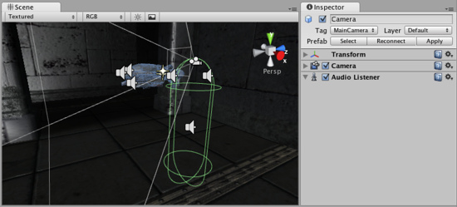
Audio Listener
This is a component that's automatically attached to the main camera every time you create a scene. It doesn't have any properties, since its only job is to act as the point of perception. Leaving the Audio Listener as it is, is recommended.

Slide 30
This is the component that's actually responsible for playing the sound. In common development practice, it's generally a good idea to make an empty gameObject to act as the Audio Source and make it a child when you're dealing with large, complex structures, so you have a clear idea of where the Audio Source is.
The Audio Source component has quite a few properties which we can tinker around with. This includes its pitch, panning, spatial blending (We'll get to that later), and if you open the 3D Sound Settings, you will find options for adding Doppler Effects and volume rolloffs.
What interests us the most here is the Audio Clip slot, however. That's where the sound effect to be played goes. Unity supports quite a few common sound formats, including .mp3 and .ogg etc.
Audio Source

Slide 31
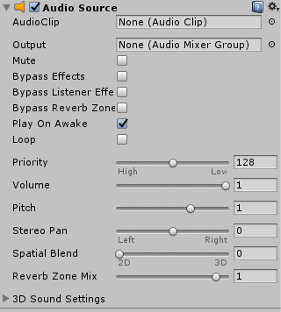

Slide 32
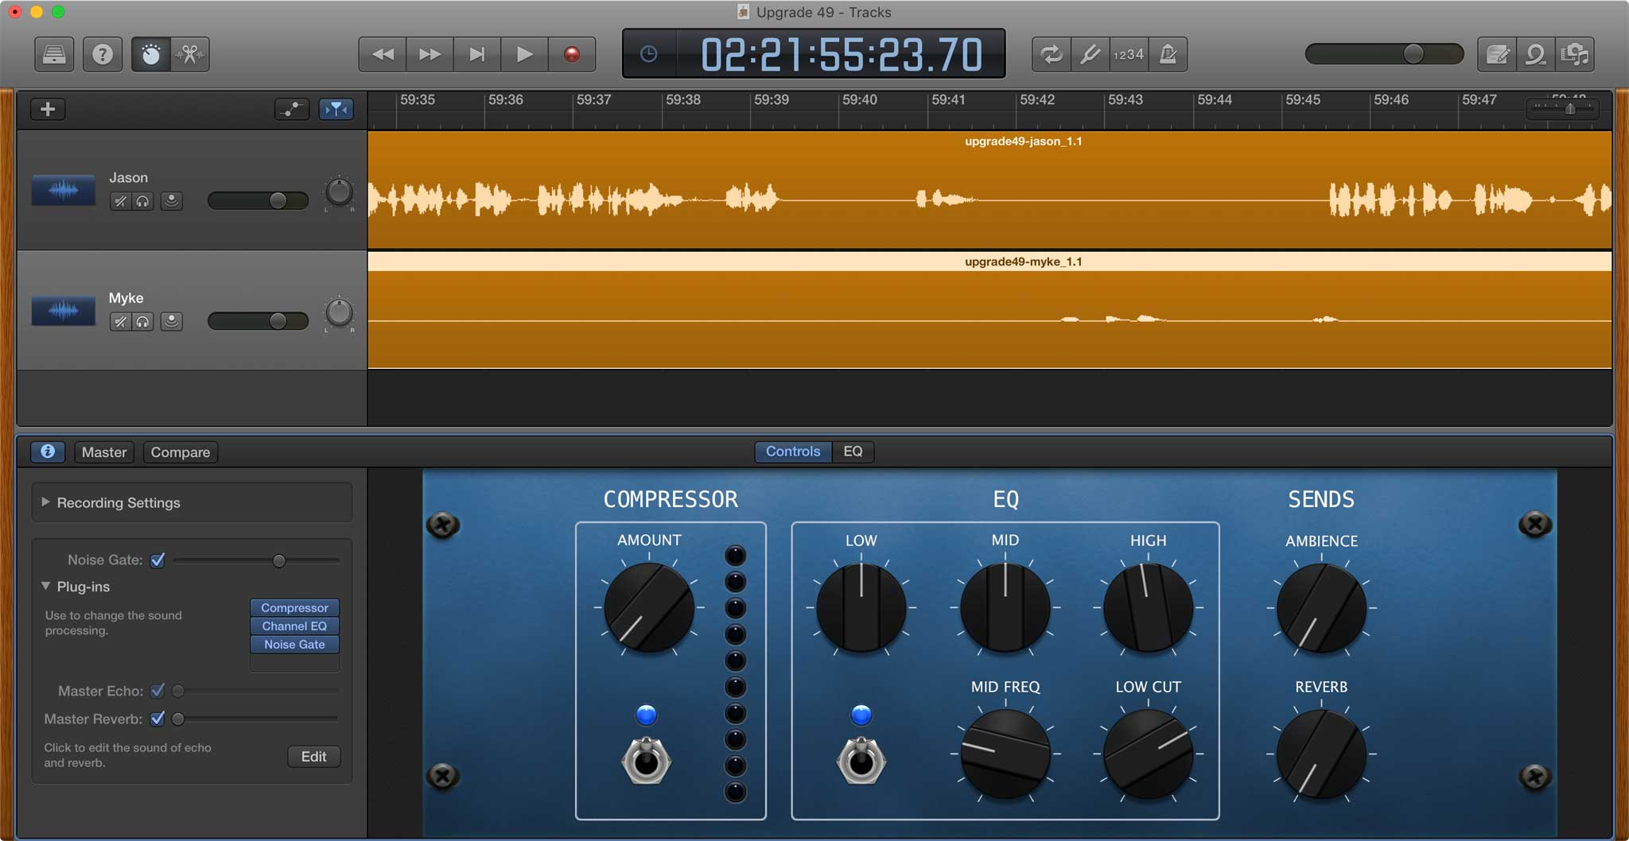

Slide 33
To create a new Audio Source:
Import our audio files into our Unity Project. These are now Audio Clips.
Go to GameObject and click Create Empty from the menu.
With the new GameObject selected in the inspector, click Add Component.
We can search for Audio Source and select this. An Audio Source will be attached to the GameObject in the inspector.
Assign our AudioClip to the Audio Source.
Once we have our Audio Source set up correctly, there are two ways to trigger sounds from a script:
The first method to achieve this would be to not have an Audio Clip Variable at all, but instead attach an Audio Source component
to your GameObject (or to the pickup object), and drag the Audio Clip into that Audio Source Component. You could then trigger
the sound by calling audio.Play(); from a script on the same object.
The second method to achieve this is would be to trigger the sound by calling AudioSource.PlayClipAtPoint(); This will play the sound at the position of the player object that this script is placed on in the 3D world.

Slide 34
using UnityEngine;
using System.Collections;
public class CrashSound : MonoBehaviour {
public AudioClip crashSoft;
public AudioClip crashHard;
private AudioSource source;
private float lowPitchRange = .75F;
private float highPitchRange = 1.5F;
private float velToVol = .2F;
private float velocityClipSplit = 10F;
void Awake () {
source = GetComponent<AudioSource>();
}

Slide 35
void OnCollisionEnter (Collision coll)
{
source.pitch = Random.Range (lowPitchRange,highPitchRange);
float hitVol = coll.relativeVelocity.magnitude * velToVol;
if (coll.relativeVelocity.magnitude < velocityClipSplit)
source.PlayOneShot(crashSoft,hitVol);
else
source.PlayOneShot(crashHard,hitVol);
}
}

Slide 36
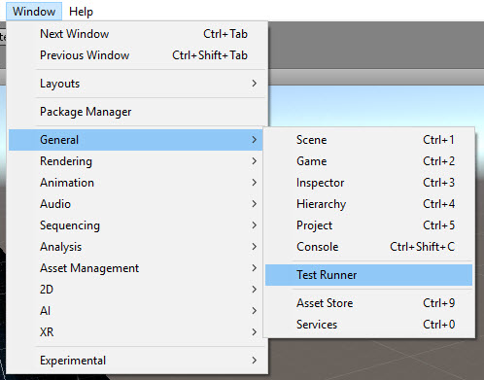
Testing
To write tests, we use Unity’s Test Runner. The Test Runner lets you run tests and see if they pass. To open the Unity Test Runner, choose Window ▸ General ▸ Test Runner.

Slide 37
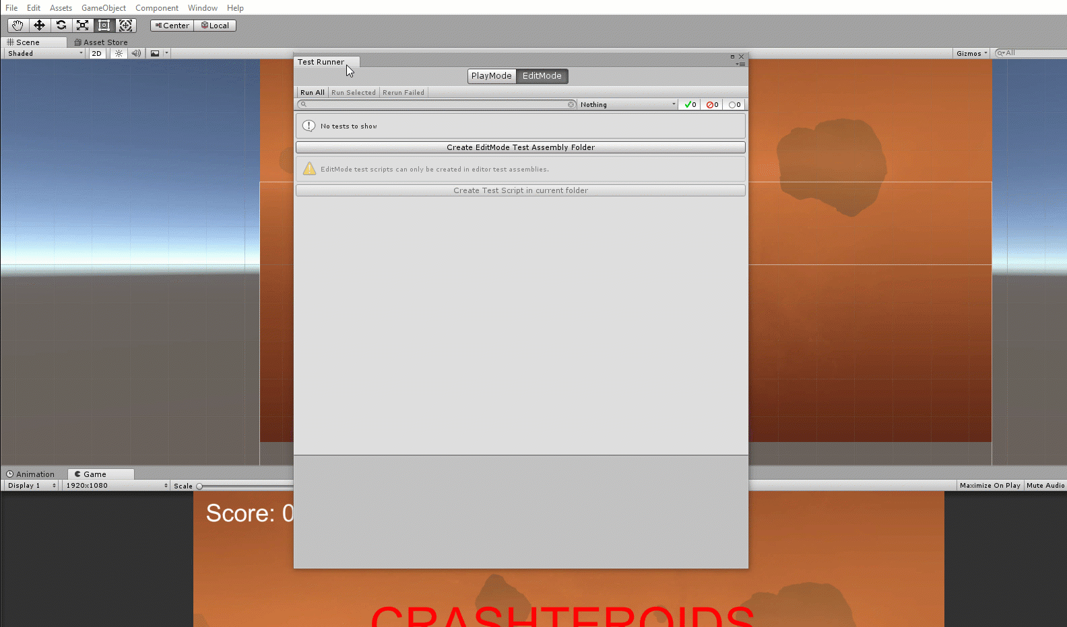
After the Test Runner opens as a new window, you can make life easier by clicking the Test Runner window and dragging it next to your Scene window.

Slide 38
Setting Up NUnit and Test Folders
Test Runner is the unit testing feature provided by Unity — but it utilizes the NUnit framework. In order to run tests, we first need to create a test folder to hold our test classes.
In the Project window, select the RW folder. Look at the Test Runner window and make sure PlayMode is selected.
Click the button which says Create PlayMode Test Assembly Folder. We will see a new folder appear just under the RW folder. The default name Tests is fine, so we can press Enter to finalize the name.

Slide 39
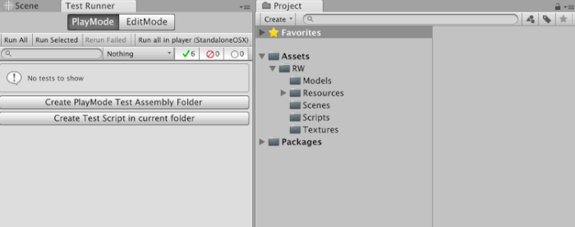

Slide 40
THANK YOU

